Slide 1
Predicting Brain Tumors from MRI scans
By Subhanshu Gupta

Slide 2
Contents
Overview
Additional Details
Classification Pipeline
Data Cleaning
Data Preprocessing
Modeling-VGG & Inception
Analysis & Results
Conclusion

Slide 3
Overview
Brain Tumors are complex. There are a lot of abnormalities in the sizes and location of the brain tumor(s). This makes it really difficult for complete understanding of the nature of the tumor.
What are the options for a Hospital to correctly identify if the patient has a Brain Tumor or not by automating the MRI scanning and study, to produce results within a day when the MRI was performed?

Slide 4
Additional Details
The project uses and compares the application of two of the well known Architectures of Convolutional Neural Networks- VGG & Inception.

Slide 5
Classification Pipeline
MRI Scans
Tumor
No Tumor
Data Wrangling
Classifier
Data Cleaning
ML Model
EDA
Data Pre-processing

Slide 6
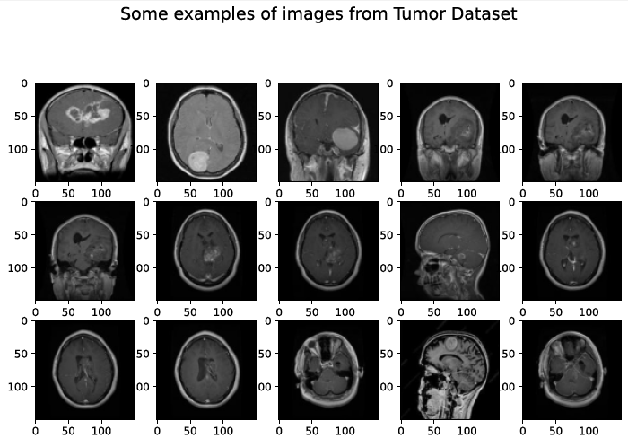
Data Cleaning
The adjoining figure shows some images (out of 3525) from the Dataset used in the project. The Dataset was cleaned to:
Make all the images to a common format-JPG.
Rename the images to a specific format: Y-<#> (with Tumor) or N-<#> (without Tumor).

Slide 7
Data Preprocessing
In this step, all the images in the dataset were:
resized to 150x150 pixels
Divided in train and test sets in 80%-20% ratio.

Slide 8
Modeling-VGG
Visual Geometry Group (VGG), is a sequential CNN developed by Oxford. A CNN with VGG-blocks is a sensible starting point when developing a new model from scratch as it is easy to understand, easy to implement, and very effective at extracting features from images.

Slide 9
Modeling-Inception
The inception module was described and used in the GoogLeNet model in the 2015 paper by Christian Szegedy, et al. titled “Going Deeper with Convolutions.”
This is a very simple and powerful architectural unit that allows the model to learn not only parallel filters of the same size, but parallel filters of differing sizes, allowing learning at multiple scales.

Slide 10
Analysis & Results
The adjoining table shows how each model performed on the same dataset. The major takeaways are:
Inception is 10% more accurate than VGG and takes nearly 75% less time to train.
 | VGG | Inception
Validation Accuracy | 86.56% | 96.25%
Time taken | 1100s/epoch | 260s/epoch
Correct Predictions with Tumor | 20/20 | 18/20
Correct Predictions without Tumor | 20/20 | 20/20
Precision | 100% | 100%
Recall | 100% | 90%
F1 Score | 1 | 0.947

Slide 11
Conclusion
This project used two of the most famous CNN Architectures for Image Classification.
The classification was performed using a contrast-enhanced MRI Image database which contained two types of images- 1) with Tumor, & 2) without Tumor.
Both the architectures showed a high Accuracy in predictions but the time taken in training VGG was 4-times the time taken to train Inception.
Inception showed more promise over VGG in terms of Accuracy as well, as Inception had a Validation Accuracy of 96% while VGG had around 86%.
These results show that Inception has a good generalization capability and good execution speed, so it could be used as an effective decision-support tool for radiologists in medical diagnostics.

Slide 12
Future Enhancements
In future, this Model can also be:
generalized to predict the type of Brain Tumors i.e, Glioma, Meningioma, and Pituitary Tumors.
One of the main improvements will be adjusting the architecture so that it could be used during brain surgery, classifying and accurately locating the tumor.
Detecting the tumors in the operating room should be performed in real-time and real-world conditions; thus, in that case, the improvement would also involve adapting the network to a 3D system.

Slide 13
Thank You!

